Slide 1
Unit 4 Lecture : 7and 8
ELASTICITY OF DEMAND
CONTENTS
Introduction
Objectives
Price Elasticity of Demand
Determinants of Demand Elasticity
Tutor-Marked Assignment
References

Slide 2
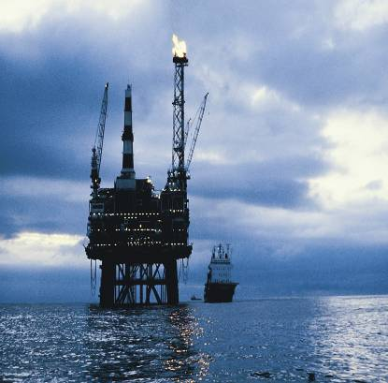
Introduction : Elasticity of Demand
Example : Do people care about the price of petrol?
The effects of high oil prices are felt throughout the economy. Households attempt to reallocate their budgets and change their consumption patterns.

Slide 3
Introduction
The law of demand states that the higher the price the lower the quantity consumers will purchased. However, the response of the quantity supply or demanded to changes in price is unknown. Therefore, we tend to ask the question of how much will the quantities demanded react to price? This question is answered by elasticity. Elasticity is a concept that is used to quantify the response in one variable when there is change in another variable. Knowing the size and magnitude of this reaction is very imperative.

Slide 4
OBJECTIVES
At the end of this unit, you should be able to:
define elasticity in relation to demand
state different types of elasticity of demand
• calculate elasticity
• explain the determinants of demand elasticity.

Slide 5
Demand and Price Elasticity
According to law of demand when prices rise, quantity demanded is expected to fall ceteris paribus (all things been equal). This shows that there is a negative relationship between price and demand. The negative relationship is replicated in the downward slope of the demand curve. Though slope of a demand curve may reflect the responsiveness of quantity demanded to price change but is not a good measure of responsiveness.

Slide 6
Price Elasticity
Price elasticity of demand can be described as proportional or percentage change in quantity demanded as a result of proportional or percentage change in that commodity’s price.
How price elasticity is measured: Divide the percentage change in the quantity demanded of a product by the percentage change in the product’s price.

Slide 7
The price elasticity of demand and its measurement
Note: The price elasticity of demand is not the same as the slope of a demand curve.

Slide 8
The price elasticity of demand is the percentage change in quantity demanded divided by the percentage change in price. Symbolically we may write
E_{d} =
Or E_{d} = or E_{d} =

Slide 9
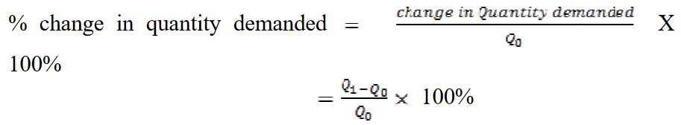
Calculation of Percentage change in Quantity Demanded
Let assume that quantity demanded of chicken increased from 6kg (Q0) to 12kg (Q1) due to decrease in price from $10 to $7. To calculate the percentage change in quantity demanded using the above formula, we have:

Slide 10
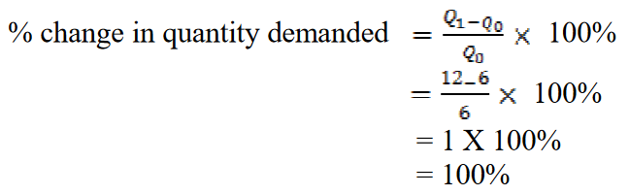

Slide 11
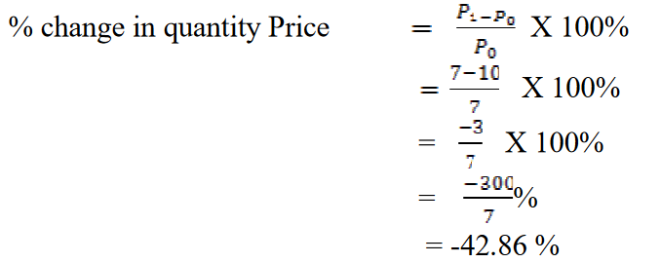
Calculation of Percentage change in Price
Percentage change in price can also be calculate using a similar formula as shown above using the Chicken change in price from $10 (P0) to $7 (P1) as an example:

Slide 12
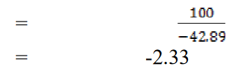
Computing the Price Elasticity of Demand
From the above calculation on Chicken:
% change in quantity demanded is 100%
% change in price is 42.89 percent (42.89 will carry a minus sign due to decrease in price) .
Hence we have

Slide 13
The Midpoint Method: A Better Way to Calculate Percentage Changes and Elasticities
The midpoint formula is preferable when calculating the price elasticity of demand because it gives the same answer regardless of the direction of the change. Using the midpoint formula to calculate percentage change has been recommended by Case and Fair (1999).

Slide 14


Midpoint formula
Midpoint formula describes more accurately the percentage change. It can be define as a way of calculating percentage change in demand and price using the halfway values between Q1 and Q2 and P1 and P2.

Slide 15
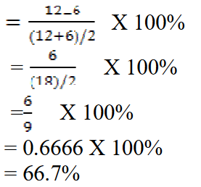
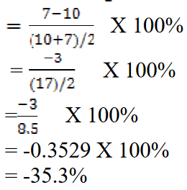
Midpoint formula - Example
% change in quantity demanded
% change in price

Slide 16
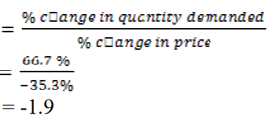
Example
Now that we know that:
% change in quantity demanded = 66.7%
% change in price = -35.3%
Price elasticity of demand

Slide 17
Calculate price elasticity of demand with extreme cases
Introduction : The price elasticity of demand coefficient can range from a value of zero to a value that is infinitely large, but economists typically divide elasticity coefficients into three broad categories:
Elastic demand:
When E_{d} > 1 means that a 1 percent change in price calls forth more than a 1 percent change in quantity demanded, the good has price-elastic demand. Example : luxury goods.

Slide 18
Inelastic demand:
When E_{d} < 1 means that a 1 percent change in price evokes less than a 1 percent change in quantity demanded, the good has price inelastic demand. Example : necessary goods
Unitary elastic
When E_{d} = 1 means that the percentage change in quantity demanded is exactly the same as the percentage change in price, the good has unit elastic demand.

Slide 19
For instance, if 5 per cent increase in price of petrol drives down the quantity of petrol demanded by 5 per cent. Then elasticity is calculated as follow:
-5 / 5 = -1

Slide 20
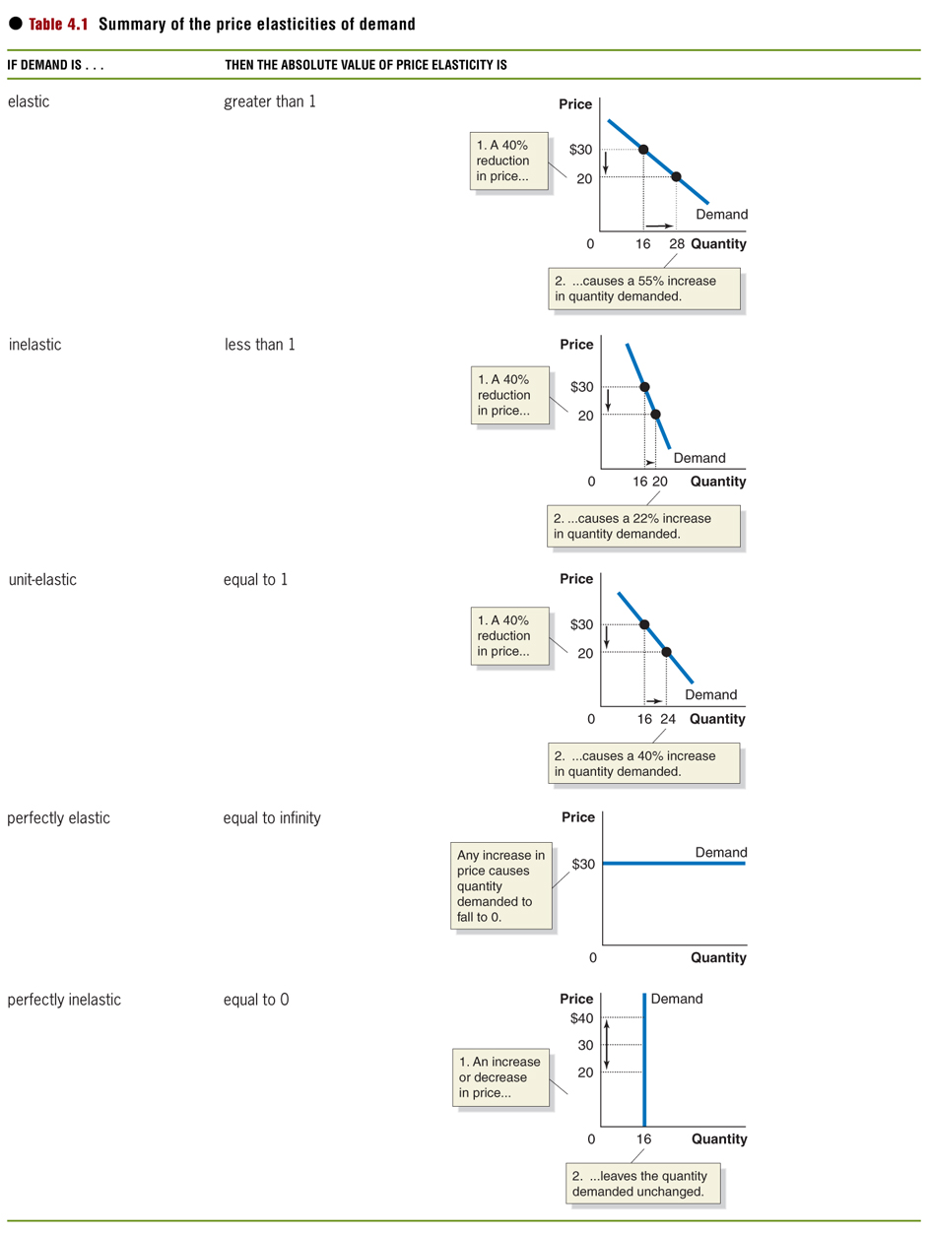
Summary of the price elasticities of demand

Slide 21
Perfectly Elastic Demand
Perfectly elastic demand occurs when the quantity demanded dropped to zero with a little price change. This usually occurs when producers can only sell their product at a market predetermined price. Any attempt to increase the price by a small amount will drive quantity demanded to zero because consumers can easily buy from other producers who complied with the market regulated price.

Slide 22
Example:
If the price of a bushel of wheat is fixed in the world market at $40, any attempt by Russian government to raise its own price by $1 may lead to zero demand for Wheat from Russia as consumers can get from other suppliers in the world market. Perfect elastic demand curve is a horizontal line (because producers can only sell at a fixed price).

Slide 23
Perfectly In- elastic Demand
This is a case where quantity demanded does not respond to increase in price i.e. the percentage change in quantity demanded is zero then the elasticity of such commodity is also zero. For instance if quantity demanded of needle remain the same despite changes in price then the demand curve for needle will be a vertical line. Then we say needle has inelastic demand.

Slide 24
Therefore perfectly inelastic demand is a demand wherein quantity demanded does not respond at all to price change.
For example if 20 percent increase in price of needle occurred but the quantity demanded remains the same i.e. there is no responsiveness at all to change in price. Then the elasticity of needle will be:
0 / 20 = 0

Slide 25
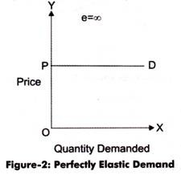
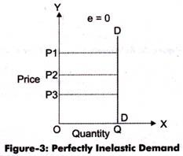
Figure : Perfectly elastic and inelastic

Slide 26
Measuring elasticity of demand – Problem
A study conducted by the Australian Medical Association suggests that every 10 per cent increase in the price of cigarettes is associated with a 5 per cent decrease in the quantity of cigarettes demanded.
a) Use the figures from this study to calculate the price elasticity of demand for cigarettes.
b) On the basis of your findings, does this suggest that increasing the price of cigarettes will substantially decrease smoking.

Slide 27
Measuring elasticity of demand : Solving the problem
Answer (a) : using the following formula:

Slide 28
Measuring elasticity of demand : Solving the problem
Insert the percentage changes from the question into the formula:

Slide 29
Measuring elasticity of demand : Solving the problem
Answer (b) on the basis of the answer to (a).
We find that price elasticity of demand for cigarettes is less than one, or inelastic. This is not unexpected. Cigarette smoking is a difficult habit to give up. An increase in price alone is insufficient to induce people to break this habit.

Slide 30
SELF-ASSESSMENT EXERCISE
What is elasticity? Mention and define its different types.

Slide 31
The Price Elasticity of Demand and Its Determinants
Availability of Close Substitutes : Goods with close substitutes tend to have more elastic demand because it is easier for consumers to switch from that good . For example if price of close-up tooth paste went up, if the prices of other tooth pastes like Dabur herbal, oral B, Pepsodent tooth pastes remain the same;

Slide 32
then they are cheaper than close-up. Consumer will shift easily to any of the other tooth pastes. Hence the demand elasticity of close-up will be very elastic such that a little increase in price will drive down the quantity demanded for it rapidly.
Time Horizon: Goods tend to have more elastic demand over longer time horizons.

Slide 33
Necessities versus Luxuries: Necessities tend to have inelastic demands, whereas luxuries have elastic demands.
Definition of the Market: The elasticity of demand in any market depends on how we draw the boundaries of the market. Narrowly defined markets tend to have more elastic demand than broadly defined markets, because it is easier to find close substitutes for narrowly defined goods.

Slide 34
Addict or habit
People that are addicted to some product consumed out of their habit which ‘die hard’ are another factor that can determine demand elasticity. Smokers and drunkards who consume cigarette and alcohols out of habit will not budge from buying their brands despite increase in price. As such, elasticity of demand for these products will be inelastic.

Slide 35
Importance of a commodity
The greater the uses of a product the more its price elasticity. For example, ginger powder is not only use for soup seasoning, but can be included in, fried rice, beans porridge, oat meal, and can even be added to black tea, green tea or used to make pure ginger tea. For these alternative uses it can be put to, its demand becomes very elastic. Increase in price of ginger may lead to decrease in quantity demanded.

Slide 36
SELF-ASSESSMENT EXERCISE
List the determinants of elasticity of demand. Explain them with examples.

Slide 37
What determines price elasticity of demand?
Total revenue: the total amount of funds received by a seller of a good or service.
Total revenue is found by multiplying price per unit by the number of units sold.
TR = P x Q

Slide 38
The relationship between price elasticity and total revenue
When demand is price elastic:
A decrease in price leads to an increase in total revenue.
An increase in price leads to a decrease in total revenue.
When demand is price inelastic:
A decrease in price leads to a decrease in total revenue.
An increase in price leads to an increase in total revenue.

Slide 39
The relationship between price elasticity and total revenue

Slide 40
The relationship between price elasticity and total revenue

Slide 41
The relationship between price elasticity and total revenue
If demand is … | Then … | Because …
elastic | an increase in price reduces revenue | the decrease in quantity demanded is proportionally greater than the increase in price
elastic | a decrease in price increases revenue | the increase in quantity demanded is proportionally greater than the decrease in price

Slide 42
The relationship between price elasticity and total revenue: continued
If demand is … | Then … | Because …
inelastic | An increase in price increases revenue | the increase in quantity demanded is proportionally greater than the increase in price
inelastic | a decrease in price reduces revenue | the decrease in quantity demanded is proportionally smaller than the increase in price

Slide 43
The relationship between price elasticity and total revenue: continued
If demand is … | Then … | Because …
unit-elastic | an increase in price does not affect revenue | the decrease in quantity demanded is proportionally the same as the increase in price
unit-elastic | a decrease in price does not affect revenue | the increase in quantity demanded is proportionally the same as the decrease in price

Slide 44
Other demand elasticities
Cross price elasticity of demand: the percentage change in the quantity demanded of one good divided by the percentage change in the price of another good.

Slide 45
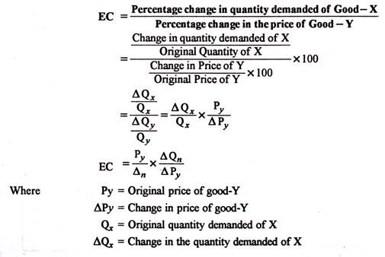
Cross price elasticity

Slide 46
Cross price elasticity
Cross price elasticity will be positive when the two goods are substitutes in consumption.
Toothpaste is an example of a substitute good; if the price of one brand of toothpaste increases, the demand for a competitor's brand of toothpaste increases in turn.

Slide 47
Cross price elasticity will be negative when the two goods are complements in consumption.
A negative cross elasticity of demand indicates that the demand for good A will decrease as the price of B goes up. This suggests that A and B are complementary goods, such as a printer and printer toner. If the price of the printer goes up, demand for it will drop.

Slide 48
Summary of cross-price elasticities of demand
If the products are … | Then the cross-price elasticity of demand will be … | Example
substitutes | positive | two brands of printers
complements | negative | printers and toner cartridges
unrelated | zero | printers and peanut butter

Slide 49
Cross price elasticities - Problem
Would you expect the cross price elasticity between the following pairs of goods to be positive or negative? Explain your answers.
a) Coke and Pepsi.
b) DVD players and DVDs.
c) Gucci sunglasses and vegemite.

Slide 50
Cross price elasticities – Solving the Problem
(a) Coke and Pepsi are the classic example of two goods which are substitutes in consumption. An increase in the price of Coke would, therefore, lead to an increase in demand for Pepsi, so the cross-price elasticity would be positive.
(b) DVD players and DVDs are complements in consumption. An increase in the price of DVD players would see a decrease in demand for DVD players, and hence a decrease in demand for the complement DVDs. The cross-price elasticity between the two goods would, therefore, be negative.
(c) Gucci sunglasses and vegemite are completely unrelated goods, therefore, we would expect the cross price elasticity to equal zero.

Slide 51
Other demand elasticities
Income elasticity of demand: A measure of the responsiveness of quantity demanded to a change in income.
Measured by the percentage change in quantity demanded divided by the percentage change in income.

Slide 52
Summary of income elasticity of demand
If the income elasticity of demand is … | Then the good is … | Example
Positive, but less than 1 | normal and a necessity | milk
Positive and greater than 1 | normal and a luxury | caviar
Negative | an inferior good | high-fat meat

Slide 53
Quiz
Q1. If you know the value of the price elasticity of demand, then which of the following can you compute?
The effect of a price change on the quantity demanded.
The responsiveness of the quantity supplied of a good to a change in its price.
The price elasticity of supply.
All of the above

Slide 54
Quiz
Q1. If you know the value of the price elasticity of demand, then which of the following can you compute?
The effect of a price change on the quantity demanded.
The responsiveness of the quantity supplied of a good to a change in its price.
The price elasticity of supply.
All of the above

Slide 55
Quiz
Q2. How do economists avoid confusion over different units of measurement in the computation of elasticities?
By using aggregate values rather than single values.
By using whole numbers rather than fractions.
By using percentage changes.
By using computer software packages.

Slide 56
Quiz
Q2. How do economists avoid confusion over different units of measurement in the computation of elasticities?
By using aggregate values rather than single values.
By using whole numbers rather than fractions.
By using percentage changes.
By using computer software packages.

Slide 57
Quiz
Q3. When demand is price inelastic, what is the relationship between price and total revenue?
They move in the same direction.
They move in opposite directions.
When price changes, total revenue remains the same.
They are unrelated.

Slide 58
Quiz
Q3. When demand is price inelastic, what is the relationship between price and total revenue?
They move in the same direction.
They move in opposite directions.
When price changes, total revenue remains the same.
They are unrelated.

Slide 59
Quiz
Q4. Fill in the blanks: If an increase in the price of a substitute leads to ________ in quantity demanded, the cross price elasticity of demand is ________ .
an increase; positive.
an increase; negative.
a decrease; positive.
a decrease; negative.

Slide 60
Quiz
Q4. Fill in the blanks: If an increase in the price of a substitute leads to ________ in quantity demanded, the cross price elasticity of demand is ________ .
an increase; positive.
an increase; negative.
a decrease; positive.
a decrease; negative.

